Slide 1

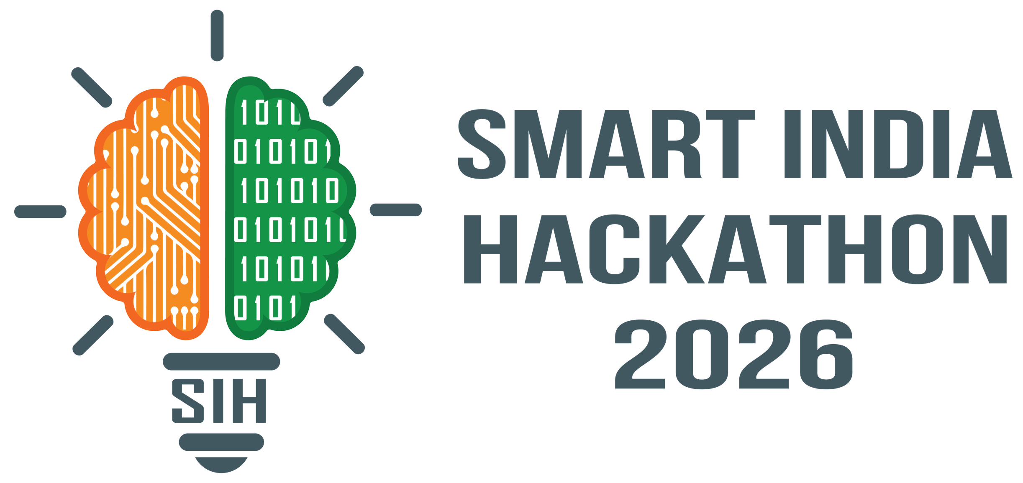

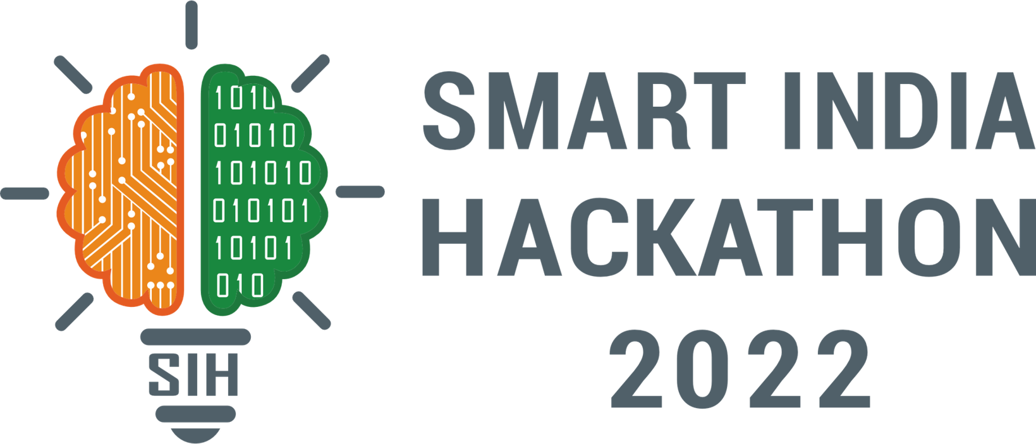
SMART INDIA HACKATHON 2026
TITLE PAGE
Problem Statement ID – 26154
Problem Statement Title- Gen AI Platform for Automated Content Transformation
Theme- Smart Automation
PS Category- Software
Team ID-373
Team Name- PHI Tech

Slide 2

IDEA TITLE
Our solution is an AI powered content transformation platform that convert a single source - report , PDF, article , image or prompt Into multi communication formats. A shared content spine ensures factual consistency while allowing user to customize audience , language , detail and style across all generated output.
The current process of converting information into different communication formats is largely manual and requires repeated effort, multiple tools, and different content-generation workflows. This creates delays, increases resource requirements, and can introduce inconsistencies between different versions of the same information.
Innovation and Uniqueness:
Our AI understands the content and extracts the important information from it.
Our Content Spine keeps all the generated outputs consistent with the original source, reducing factual errors and information loss.
We are building a platform where users can upload their content once—whether it’s a PDF, report, article, image, video, or even a simple prompt.
@SIH Idea submission- Template
2

Slide 3
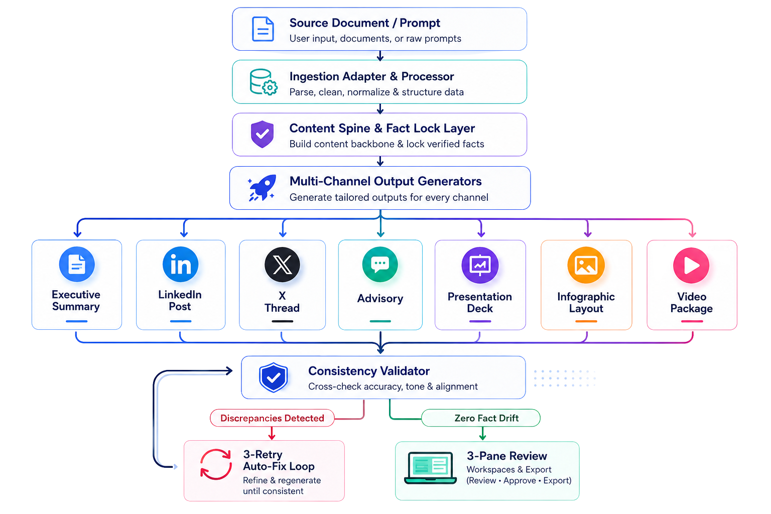
TECHNICAL APPROACH
Layer | Technology
Frontend | React + TypeScript
Backend | Node.js + Express
Database | PostgreSQL
AI Models | OpenAI/Gemini/Llama
Vector Search | pgvector
@SIH Idea submission- Template
3

Slide 4



FEASIBILITY AND VIABILITY
Uses existing AI models, OCR, and media-processing technologies.
Modular architecture makes the platform easy to build and scale.
Can be developed as a working
prototype within SIH timelines.
Processing complex inputs like scanned PDFs, images, and videos.
Maintaining quality across different output formats.
Privacy and security of sensitive
documents.
AI hallucinations and factual
inconsistencies
Feasibility
Key Challenges
Content Spine + Fact Lock to maintain accuracy.
Validation layer to detect inconsistencies before deliver
Human review before final output
Our Approach
@SIH Idea submission- Template
4

Slide 5




IMPACT AND BENEFITS
Potential Impact
Key benefits
Helps organisation turn information into useful communication much faster
Reduces repetitive manual work for content and communication teams.
Makes communication more consistent, accurate and audience friendly.
Useful for government, enterprises, research, cybersecurity and
media teams
Social: Faster and clearer public communication
Economic: Saves time ,manpower and content-production costs.
Operational: One source can generate multiple outputs in minutes.
Environmental: Reduces paper-based workflows and unnecessary resourse consumption.
@SIH Idea submission- Template
5

Slide 6
RESEARCH AND REFERENCES
IndiaAI Mission – Government of India: Reference for India’s national AI ecosystem, AI applications, innovation, and responsible AI. IndiaAI Mission – Government of India
IndiaAI & AI-driven Governance – MeitY/PIB: Government initiatives around AI adoption across ministries and public-service use cases. AI-driven Governance and Public Service Delivery – PIB
IndiaAI Safe & Trusted AI – MeitY/PIB: Reference for trustworthy, explainable, privacy-preserving and responsible AI—directly relevant to our Content Spine and validation layer. Safe & Trusted AI – PIB
Generative AI – MeitY/PIB: Government reference explaining Generative AI's ability to create new content from text, audio and images. Generative Artificial Intelligence – PIB
@SIH Idea submission- Template
6

